Slide 1

Why study biology? Hmm, because life is happing all around you everyday.
- you must breath, eat, and expel wastes
- you taste the food you eat
- you feel pain when injured, you bleed when cut
- your muscles get sore, your back aches
- you tire, sleep, and awaken
- you get sick, you get well
- you form complex relationships
- you interact with other living and non-living things
- you feel wind, see trees grow, and hear birds chirp
- you smell fresh cut grass
- you enjoy laughing with friends
You may say you are not interested in biology but life puts you center stage everyday!
We are going to try to explain the “why” and “how” some of these things occur in not only you, but in all living things!

Slide 2
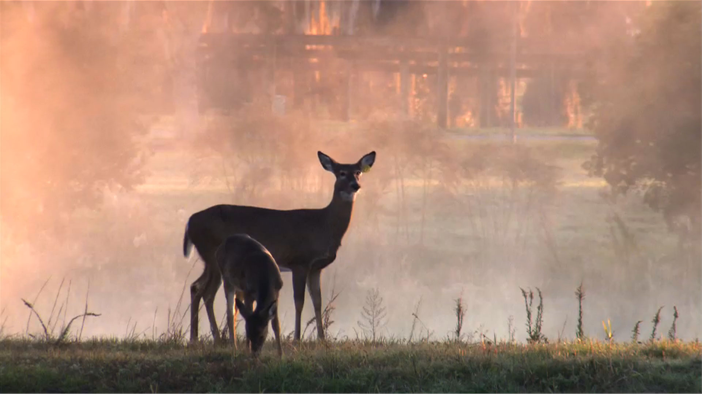
Biology: The Science of Life

Slide 3
Science as a process.
Science is a state of knowing: having knowledge as opposed to ignorance or misunderstanding.
The systematic study of the structure and behavior of the physical and natural world through observation and experiment.

Slide 4
Unifying Principles of Biology
As we study the science of biology, certain principles form the foundation of knowledge already acquired by many individuals over centuries of observation and experimentation.

Slide 5
Unifying Principles of Biology
______________________________________________________________________________________
______________________________________________________________________________________
______________________________________________________________________________________
______________________________________________________________________________________
______________________________________________________________________________________
______________________________________________________________________________________
______________________________________________________________________________________
______________________________________________________________________________________
______________________________________________________________________________________
Cell Theory
Gene Theory
Homeostasis - feedback and regulation
Structure and function
Levels of organization
Interdependence of living things
Evolution of life

Slide 6
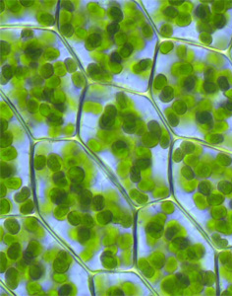
The Cell Theory
All living things (organisms) are made up of cells.
Cells always come from other living cells.
Cells are the basic unit of structure and function in living things.
_______________________________________________________
_______________________________________________________
_______________________________________________________
_______________________________________________________
_______________________________________________________
_______________________________________________________
_______________________________________________________
_______________________________________________________
_______________________________________________________
_______________________________________________________

Slide 7
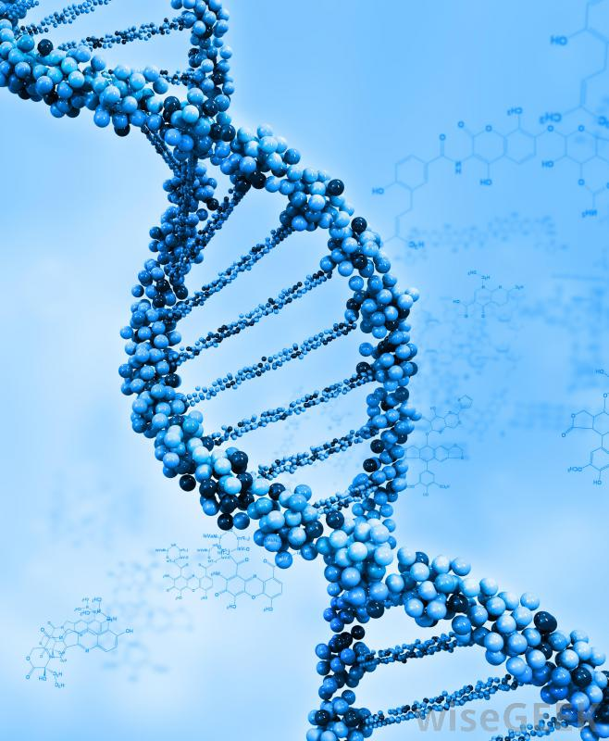
The Gene Theory
Characteristics of living things are controlled by genes.
Genes are located on chromosomes which are in every cell.
Genes are made up of DNA and are passed from parents to offspring.
_______________________________________________________
_______________________________________________________
_______________________________________________________
_______________________________________________________
_______________________________________________________
_______________________________________________________
_______________________________________________________
_______________________________________________________
_______________________________________________________
_______________________________________________________

Slide 8
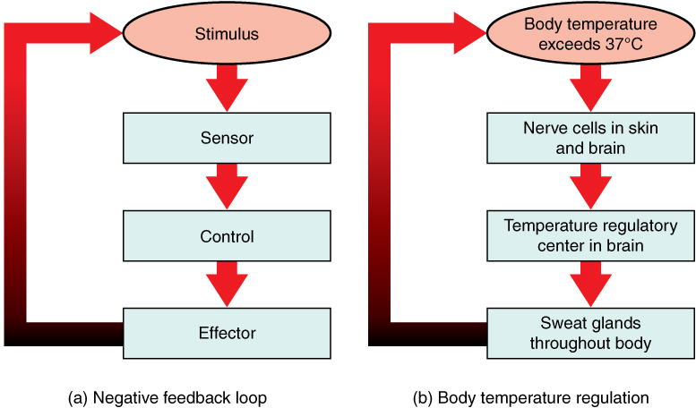
Homeostasis
Keeping things constant.
Uses feedback and regulatory mechanisms.
Not only applies to living things but nature as a whole.
_________________________________
_________________________________
_________________________________
_________________________________
_________________________________
_________________________________
_________________________________
_________________________________
_________________________________
_________________________________
_________________________________

Slide 9
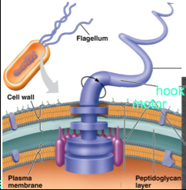
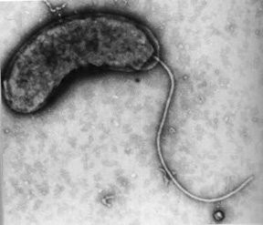
Structure and Function
Form (structure) generally fits function (job).
By studying a biological structure, you find out what it does and how it works.
Life emerges from the interactions of structures and combination of structures form an organization.
Structure = whip-like tail with a motor
Function = movement (locomotion)
_______________________________________________________
_______________________________________________________
_______________________________________________________
_______________________________________________________
_______________________________________________________
_______________________________________________________
_______________________________________________________
_______________________________________________________
_______________________________________________________
_______________________________________________________
Flagellum = singular
Flagella = plural

Slide 10
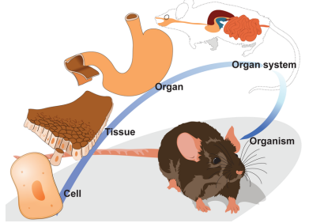
Levels of Organization
Individual organisms can be
organized at different levels.
___________________________________________
___________________________________________
___________________________________________
___________________________________________
Like cells form tissues
Several tissues form organs
Several organs form an
organ system
Several organ systems form an organism

Slide 11
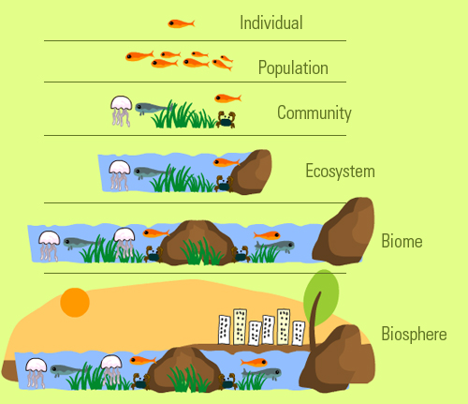
Levels of Organization (con’t)
2. The entire living part of the planet (biosphere) can be organized as well.
Individual Population
Communities
Ecosystems
Biomes
Biosphere
2.___________________________________________
______________________________________________
______________________________________________
______________________________________________
______________________________________________

Slide 12
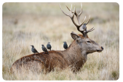
Interdependence of Living Things
All living things depend on the
environment to provide food,
water, shelter, air, and space.
2. Organisms of different species
can form symbioses – complex
relationships where at least one
organism benefits.
3. When organisms need the same
resources at the same time and
in the same place, competition
occurs.
_______________________________________________________
_______________________________________________________
_______________________________________________________
_______________________________________________________
_______________________________________________________
_______________________________________________________
_______________________________________________________
_______________________________________________________
_______________________________________________________
_______________________________________________________
What benefit do the birds get?
Answer: _________________________________
_________________________________
What benefit does the deer get?
Answer: _________________________________
_________________________________
Symbiosis = singular
Symbioses = plural

Slide 13
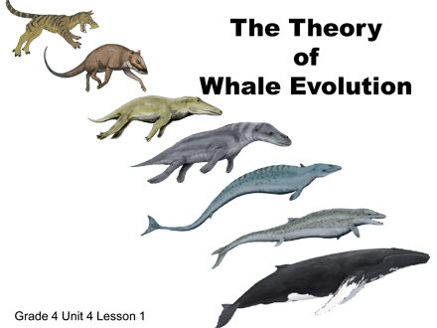
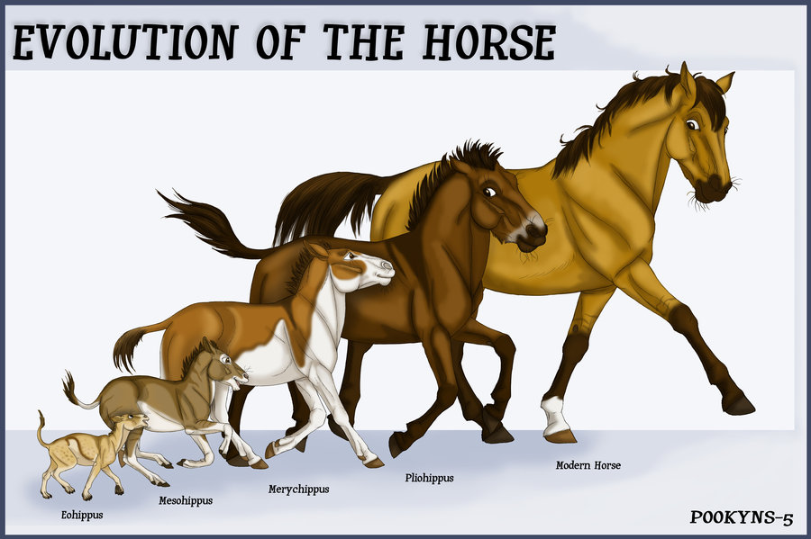
Evolution
Living things change over time due to changing environmental conditions.
2. Organisms acquire adaptations
to survive the changing
conditions or face extinction.
3. The current theory of Evolution
is change by means of natural
selection.
- the foundation of this theory
was first presented in 1850’s
by Charles Darwin.
_______________________________________________________
_______________________________________________________
_______________________________________________________
_______________________________________________________
_______________________________________________________
_______________________________________________________
_______________________________________________________
_______________________________________________________
_______________________________________________________
_______________________________________________________

Slide 14
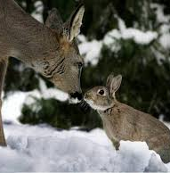
In Summary:
Science is the way to acquire knowledge in an organized way.
Biology goes on around us everyday and by studying it we get a better understanding of how it works.
Biology has some underlying principles that unify our ideas of Life.
All of these underlying principles are working together in nature and each depends upon the other.

